Slide 1
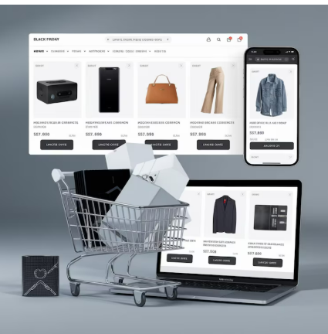
ECOMMERCE SALES ANALYSIS
BY SAURAV KUMAR 05/07/2026

Slide 2
RECOMMEDATIONS
Optimize Discount Strategy
Focus on High-Profit Product Categories
Strengthen Customer Retention
Improve Regional Performance
Improve Regional Performance

Slide 3
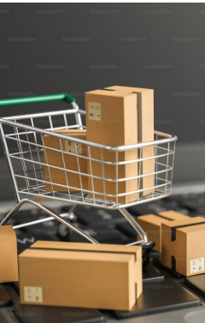
BUISNESS PROBLEM AND BUISNESS CONTEXT
An e-commerce company operates across multiple regions, customer segments, and product categories, generating thousands of sales transactions over time. Despite increasing sales, management lacks clear visibility into key business metrics such as profitability, customer purchasing behaviour, discount effectiveness, regional performance, and product profitability.
The company aims to leverage historical sales data to identify factors affecting revenue and profit, optimize pricing and discount strategies, improve customer segmentation, streamline shipping operations, and enhance overall business performance.
The objective of this project is to perform exploratory data analysis (EDA) and develop an interactive dashboard that provides actionable insights to support strategic decision-making and improve profitability.

Slide 4
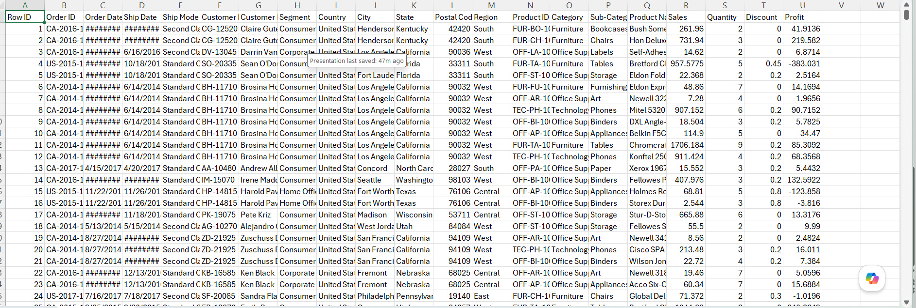
DATA OVERVIEW
The Ecommerce dataset consist of 100k+ records and have 35 features which includes the entire details about he orders of customers

Slide 5

MEHTODLOGY
Data collection
Handled missing values using appropriate imputation techniques.
Removed duplicate records to ensure data consistency.
Performed feature engineering
Identified and treated outliers to improve data quality.
Converted data types and standardized date formats for accurate

Slide 6
TOOLS & TECHNOLOGY USED
Tools & Libraries Used
Python – Data analysis and preprocessing.
Pandas – Data cleaning, manipulation, and feature engineering.
NumPy – Numerical computations and data handling.
Matplotlib – Data visualization and chart creation.
Seaborn – Statistical visualization and exploratory data analysis.
Google Colab / Jupyter Notebook – Development and analysis environment.

Slide 7
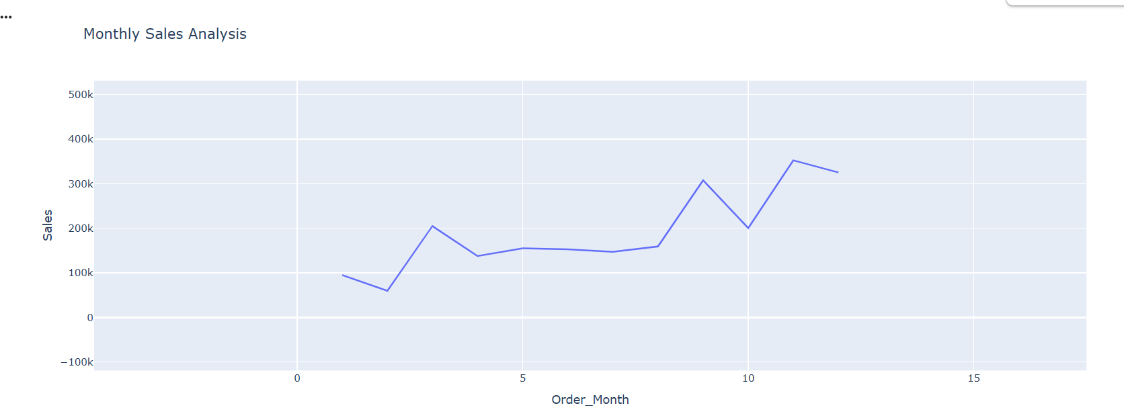
Analysis of Objective Questions
Sales peak sharply in November, likely driven by holiday-season shopping such as Black Friday and Cyber Monday, while February marks the seasonal low point — an opportunity for targeted promotions during slower months.

Slide 8
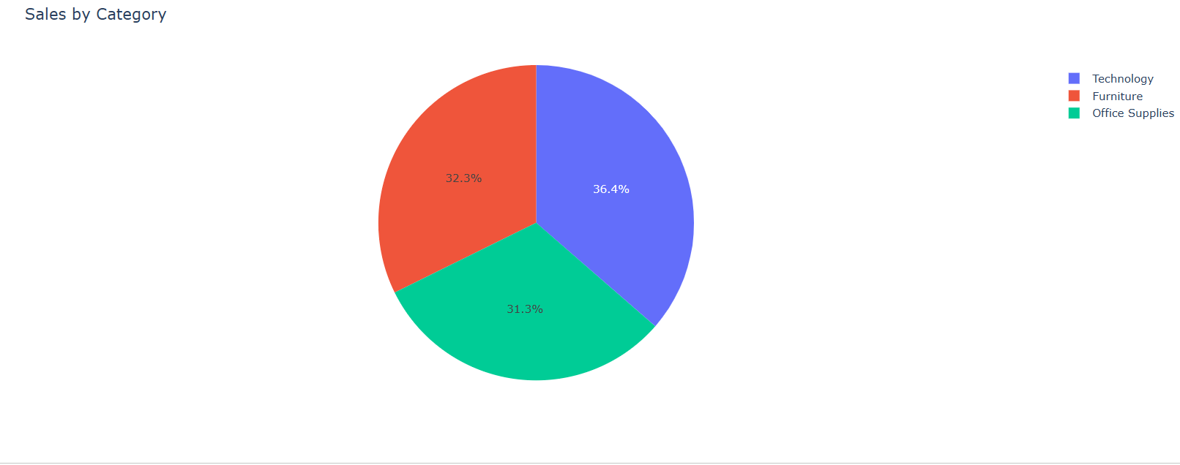
Analysis of Objective Questions
Technology products are the primary sales driver and merit continued investment, while Office Supplies may benefit from bundling or promotional strategies to boost demand.

Slide 9
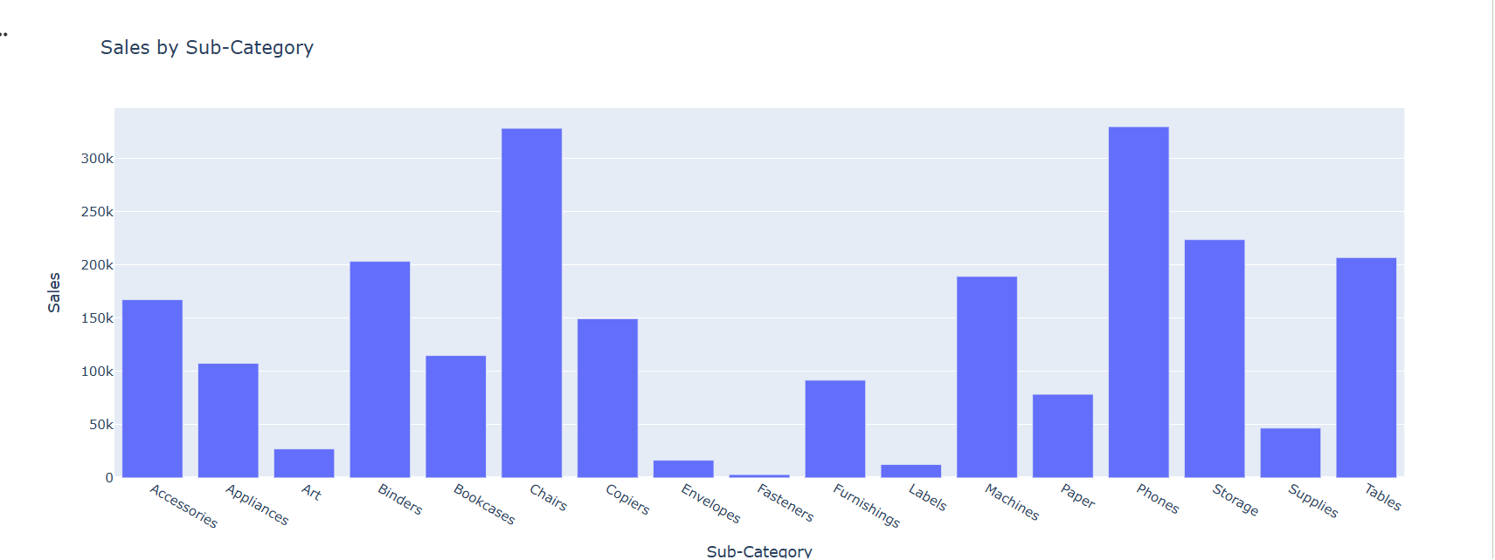
Analysis of Objective Questions
Phones are the strongest-performing subcategory and a key revenue contributor within Technology, while consistently low performers such as Envelopes warrant a review of pricing, placement, or continued stocking

Slide 10
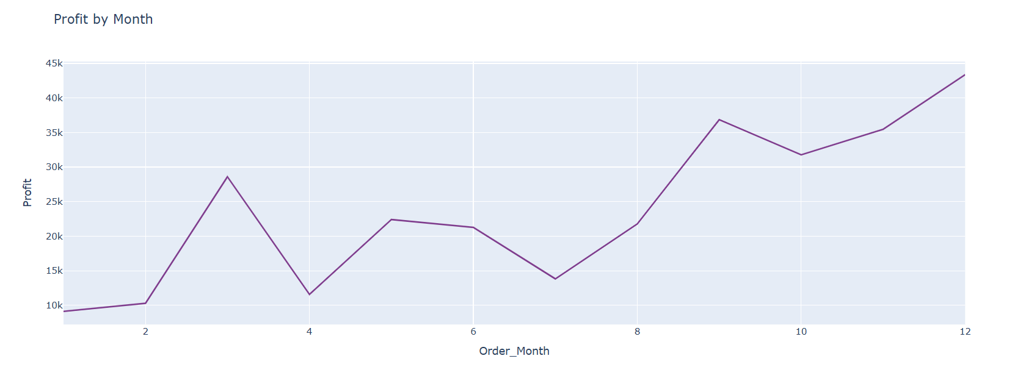
Analysis of Objective Questions
Profit peaks in December align with year-end and holiday purchasing, while the January decline suggests a post-holiday slowdown that could be offset with early-year promotional campaigns.

Slide 11
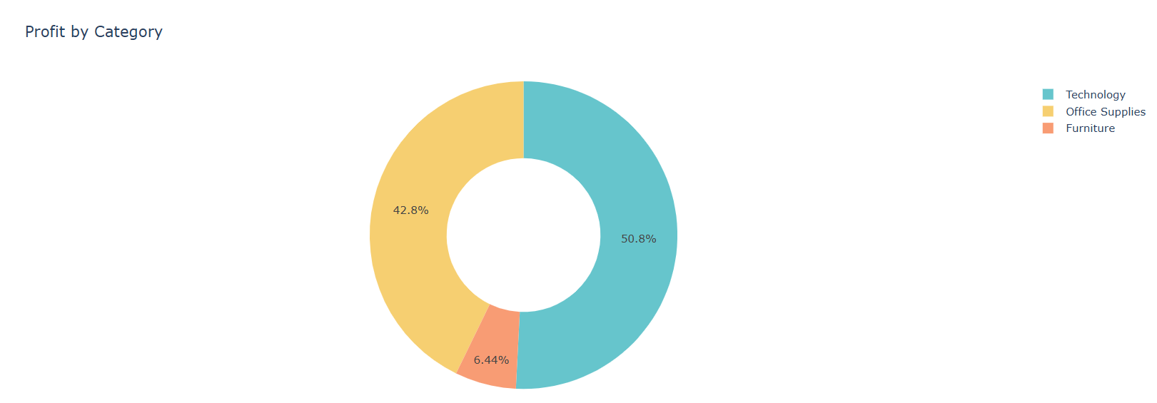
Analysis of Objective Questions
Furniture's comparatively low profit despite meaningful sales volume points to thin margins, indicating a need to review pricing or cost structure for this category

Slide 12
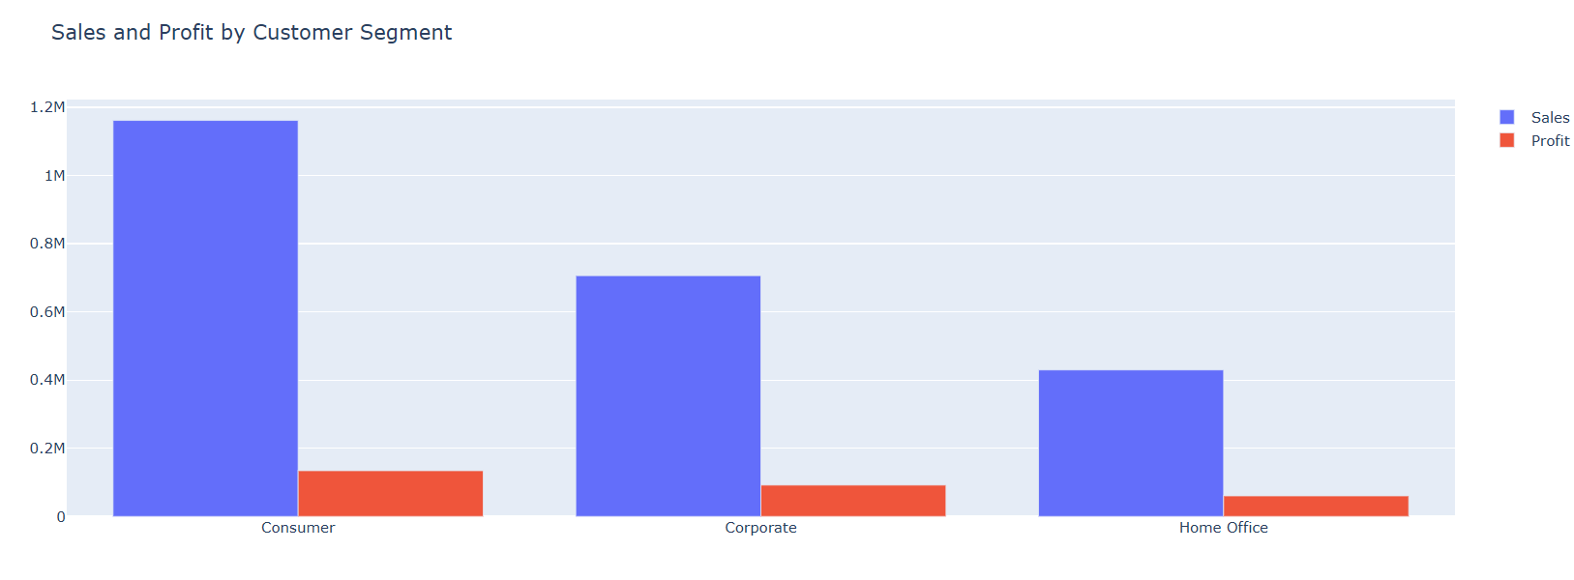
Analysis of Objective Questions
The Consumer segment is the most valuable customer group by both revenue and profit, making it the top priority for retention and loyalty initiatives.

Slide 13
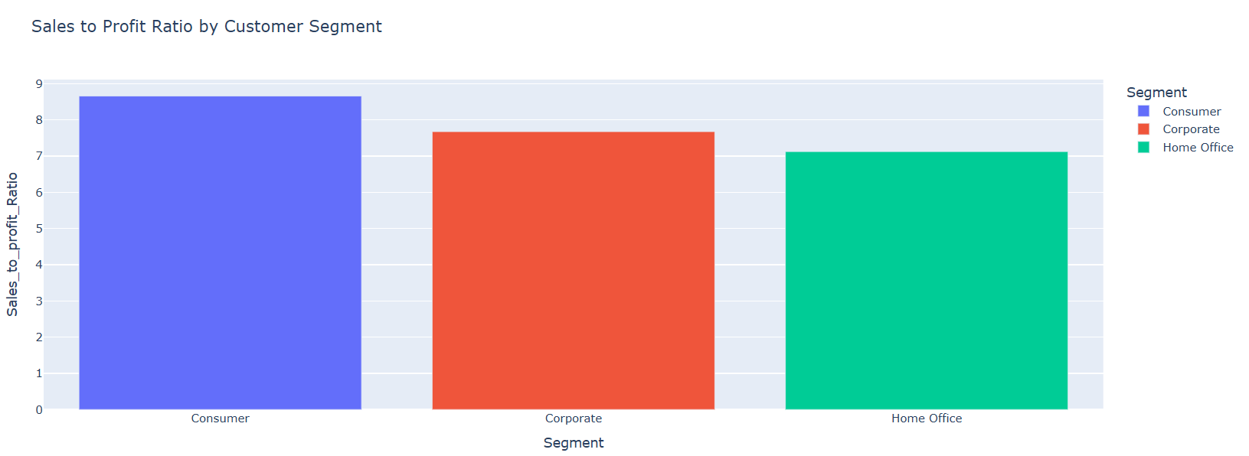
Beyond generating the most revenue, the Consumer segment also converts sales into profit most efficiently — reinforcing it as the most strategically important segment for marketing and retention investment.
Analysis of Objective Questions

